Slide 1

CCPS 506
Comparative Programming Languages
Fall 2019
Lecture 4: More advanced Elixir

Slide 2

Course Administration
Assignment description is posted
If you liked Smalltalk, you can start working on the Smalltalk version.
Elixir specifications coming soon.
Eventually (after reading week) I will post test cases for your assignments.
This way you can verify that your code is correct for simple cases

Slide 3

Any Questions?

Slide 4
Let’s Get Started!

Slide 5
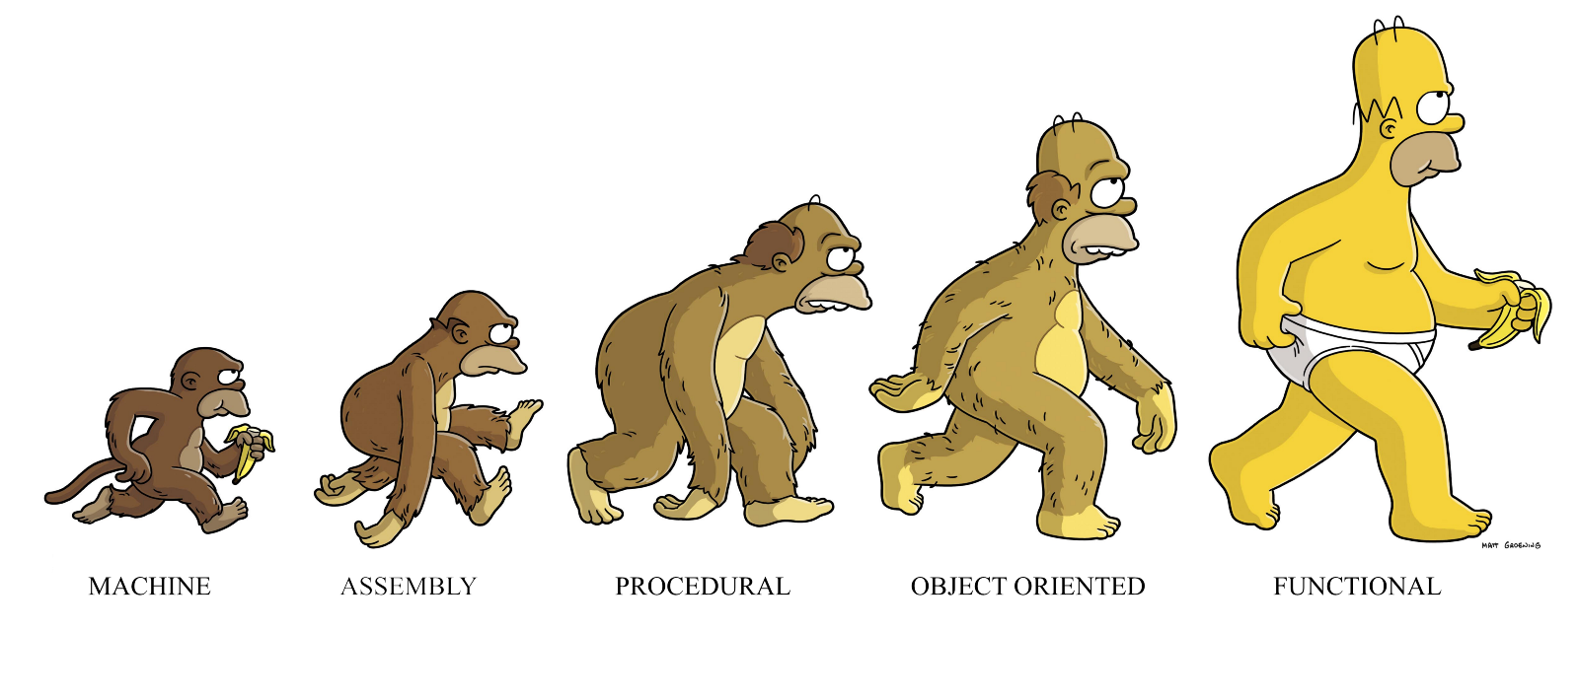
Functional Programming

Slide 6
Functional-Specific Concepts
Things that are generally foreign to imperative programming:
Pure Functions: Functions that have no side effects.
This results in several useful properties
If the return value of a pure function is not used, the function can be safely removed.
One to one mapping between function input and output.
Sometimes called referential transparency
If two pure functions do not have a data dependency, their ordering is irrelevant and they can be parallelized (thread-safe)

Slide 7
Functional-Specific Concepts
Things that are generally foreign to imperative programming:
First class functions and higher order functions:
Functions that return functions or accept them as arguments (mathematical)
In calculus, differential operator. Derivative of function is a function.
“First class” describes programming language entities that have no restriction on their use.
I.e., first class functions can appear anywhere in the program that other first class entities (such as numbers) can.
Functions as arguments, return values, etc.

Slide 8
Always Remember
Machine code is imperative.
Functional programs compile into machine code, just like imperative ones.
The distinction is in what the programmer is required to think about, and what the language hides behind the scenes.

Slide 9
Lists and Tuples
Lists
[ ], [1, 2, 3], [1, 2.0, “three”, :Four]
Stored as linked lists in memory
Tuple:
{ }, {1, 2, 3}, {1, 2.0, “three”, :Four}
Stored contiguously in memory
Both heterogeneous, both immutable

Slide 10
Moving on…

Slide 11
Today:
Pattern matching
Control structures
Recursion
Higher order & first class functions
Enum and lazy Enum with Stream

Slide 12

Pattern Matching

Slide 13
=
This is not the assignment operator. It is the match operator.
Pattern matching is a fundamental part of Elixir
x = 1
When a variable is on the left-hand side of the match operator, we bind or rebind the variable.

Slide 14
(Variable) Name on the Right?
iex> x = 2
2
iex> 2 = x
2
iex> 3 = x
** (MatchError) no match of right hand side value: 2
iex> 3 = x + 1
3
This is a valid expression!
If a match is successful, it returns the value of the right hand side of the expression. If not, a MatchError.

Slide 15
(Variable) Name on the Right?
iex> x = 2
2
iex> 2 = x
2
iex> 3 = x
** (MatchError) no match of right hand side value: 2
iex> 3 = x + 1
3
This is a valid expression!
Names on the left? Bind or rebind to value on the right.
Names on the right? Pattern match with value on the left.

Slide 16
Boring
Let’s see matching with lists:
iex> list = [1, 2, 3, 4, 5]
[1, 2, 3, 4, 5]
iex> [1, 2, 3, 4, 5] = list
[1, 2, 3, 4, 5]

Slide 17
Matching Lists
iex> list = [1, 2, 3, 4, 5]
[1, 2, 3, 4, 5]
iex> [1 | tail] = list
[1, 2, 3, 4, 5]
Separates list into head and tail.
In this case, the head must be 1!
iex> tail
[2, 3, 4, 5]
iex> [2 | tail] = list
** (MatchError) no match of right hand side
value: [1, 2, 3, 4, 5]
A pattern match will error if the sides can’t be matched

Slide 18
Not equating the tail (of tail) with anything
‘_’ can never be read from. Value discarded.
iex> tail
[2, 3, 4, 5]
iex> [2 | _] = tail
[2, 3, 4, 5]
iex> [2, 3 | test ] = tail
[2, 3, 4, 5]
iex> test
[4, 5]
Match first two values
iex> [_ | test ] = tail
[2, 3, 4, 5]
Match test with tail of tail

Slide 19
Matching Tuples
iex> tup = {:OK, "Hello"}
{:OK, "Hello"}
iex> {:OK, value} = tup
{:OK, "Hello"}
iex> value
"Hello"
When matching tuples, the comma is used as a separator.
Tuples don’t deal in head/tail
They aren’t linked lists.
Comma for tuples, | for lists.

Slide 20
iex(4)> {a | b} = {1, 2, 3, 4, 5}
** (CompileError) iex:4: misplaced operator |/2
The | operator is typically used between brackets as the cons operator:
[head | tail]
where head is a single element and the tail is the remaining of a list. It is also used to update maps and structs, via the %{map | key: value} notation, and in typespecs, such as @type and @spec, to express the union of two types

Slide 21
Matching Tuples
iex> {a, b, c} = {:hello, "World", 42}
{:hello, "World", 42}
iex> {a, b} = {:hello, "World", 42}
** (MatchError) no match of right hand side
value: {:hello, "World", 42}
This is called destructuring. a, b, c are now bound to individual elements of the tuple.

Slide 22
Pin Operator
If we use the match operator with a variable on the left side of the expression, that variable is simply re-bound to that value. For example:
iex> x = 3
3
iex> ^x = 2
** (MatchError) no match
of right hand side value: 2
iex> x = 3
3
iex> x = 2
2
This is often undesirable!
Use ^ operator to force x to hold its binding

Slide 23
Pin Operator: Lists & Tuples
iex> x = 2
2
iex> [^x, y] = [1, 3]
** (MatchError) no match of right hand side value: [1, 3]
iex> y
** (CompileError) iex:2: undefined function y/0
iex> [^x, y] = [2, 3]
[2, 3]
iex> y
3

Slide 24

Heads
Tails
We can accomplish a lot using these simple list operations.
We don’t need repetition syntax, we don’t need to index.
Practice working with lists – functional programming is built on it.

Slide 25
Control “Structures”
Implemented using function calls and pattern matching

Slide 26
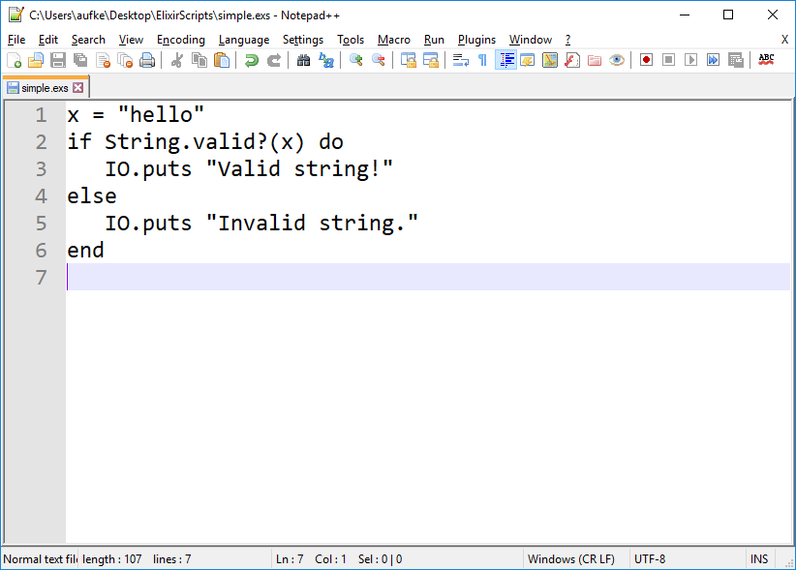
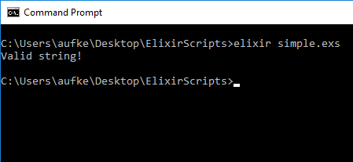
Selection: if/else

Slide 27
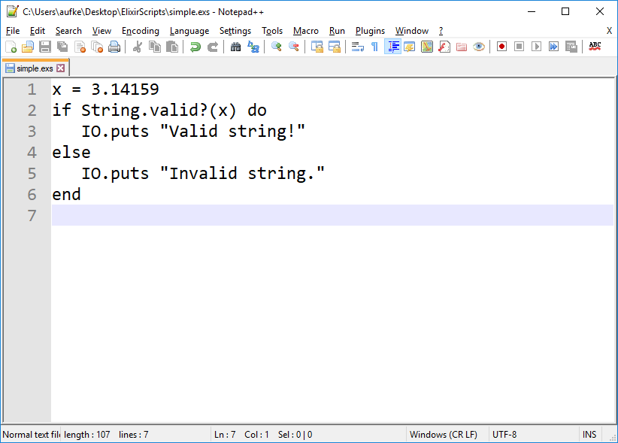
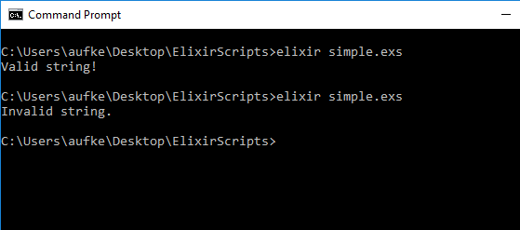

Slide 28
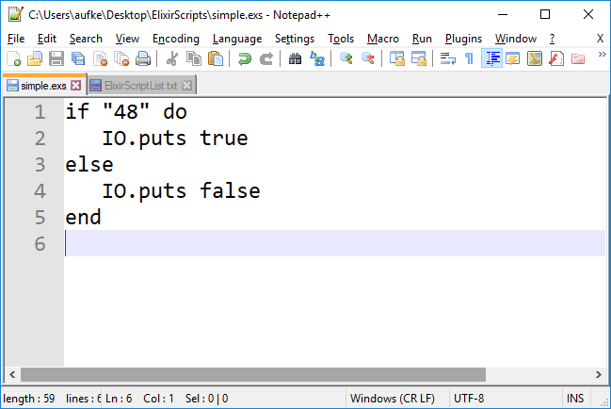
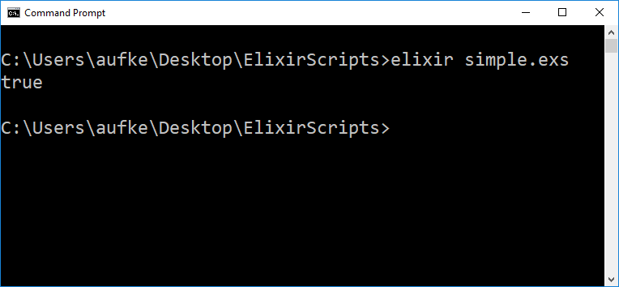
As long as this expressions evaluates to true or false
Why?

Slide 29
Boolean Expressions
With these operators:
non-false and non-nil are true.
nil and false are false.
0 is considered true!
Boolean:
true, false
&&, ||, !
iex> "gh" && false
false
iex> "gh" || false
"gh"
Except…
The result isn’t true or false
It’s the value that decided the result of true or false
What we actually get is the value that determined the truthiness of the expression

Slide 30
“No loop/if-else/case constructs”
In Elixir, we have several control structures that are implemented as macros. They are not actually constructs of the programming language.
Their implementation exists in the Elixir Kernel module.
They allow us to write if/else-style constructs in a familiar way. However, these are actually function calls behind the scenes.

Slide 31
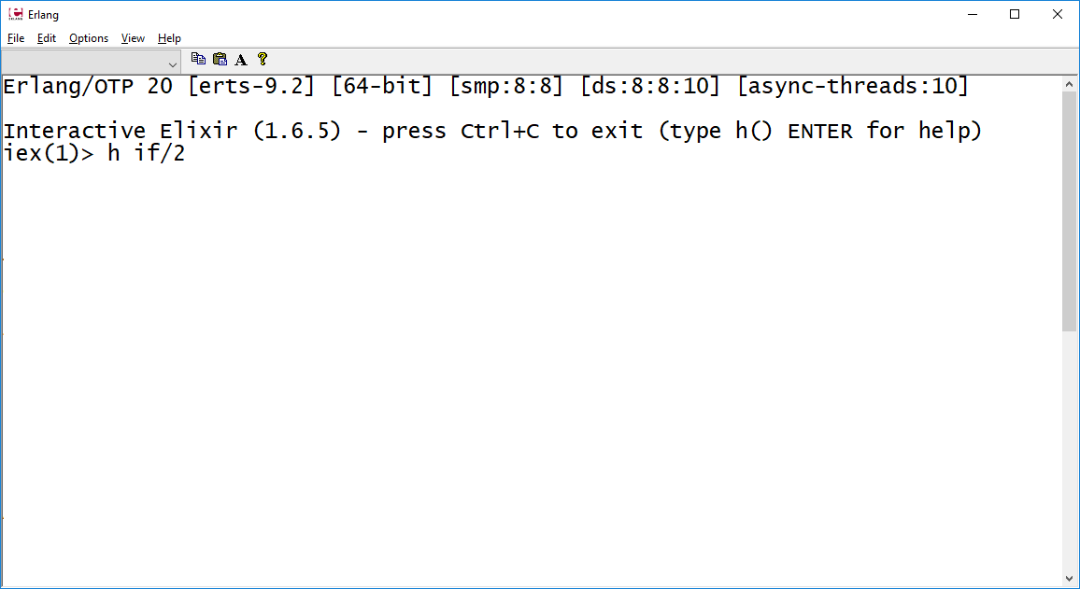
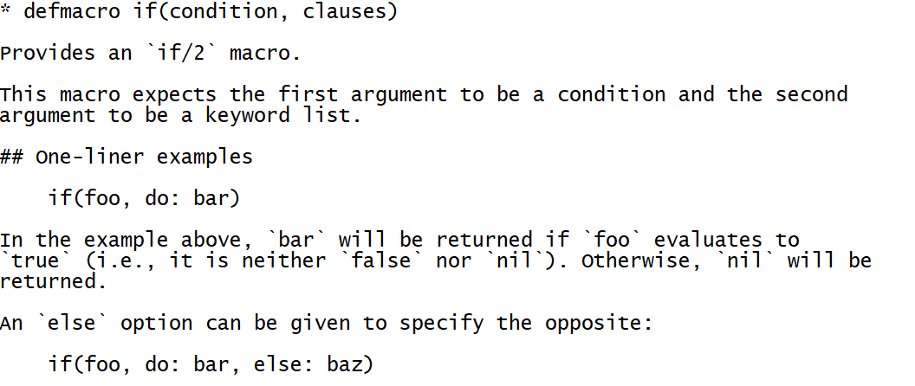
?

Slide 32
do/end VS Keyword List
if 1 < 2 do
“Hello”
end
Is the same as:
if 1 < 2, do: “Hello”
Is the same as:
if(1 < 2, do: “Hello”)
This form is merely a syntactic convenience allowed by Elixir to make the language more accessible.

Slide 33
do/end VS Keyword List
if 1 < 2 do
“Hello”
else
“World”
end
Is the same as:
if 1 < 2, do: “Hello”, else: “World”
Is the same as:
if(1 < 2, do: “Hello”, else: “World”)
iex> if 1 < 2, do: "Hello", else: "World"
"Hello"
iex> if(1 < 2, do: "Hello", else: "World")
"Hello"

Slide 34
do/end VS Keyword List
if 1 < 2 do
“Hello”
else
“World”
end
Is the same as:
if(1 < 2, do: “Hello”, else: “World”)
Is the same as:
if(1<2, [{:do, "Hello"}, {:else, "World"}])

Slide 35

if(1<2, [{:do, "Hello"}, {:else, "World"}])

Slide 36
do/end VS Keyword List
if 1 < 2 do
“Hello”
else
“World”
end
Is the same as:
if 1 < 2, do: “Hello”, else: “World”
Is the same as:
if(1<2, [{:do, "Hello"}, {:else, "World"}])
iex> if 1 < 2, do: "Hello", else: "World"
"Hello"
iex> if(1 < 2, [{:do, "Hello"}, {:else, "World"}])
"Hello"

Slide 37
Can be any expression!
iex> if(1 < 2, [{:do, IO.puts "Hello"}, {:else, "World"}])
Hello
:ok
iex>

Slide 38
unless
unless is_integer("hello") do
"Not an Int"
end
iex> unless(is_integer("hello"), do: "Not an Int")
"Not an Int"
iex> unless(is_integer("hello"), [{:do, "Not an Int"}])
"Not an Int"

Slide 39
unless: With an else
unless is_integer(0b10101) do
"Not an Int"
else
"An Int"
end
"An Int"

Slide 40
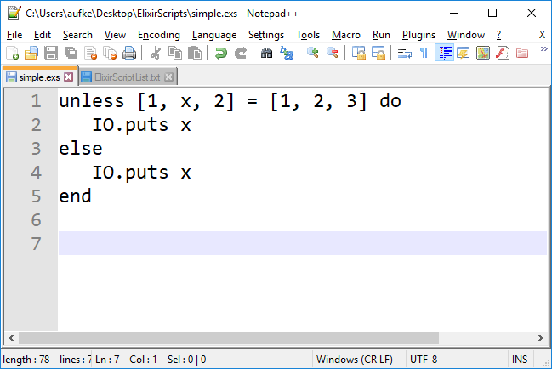
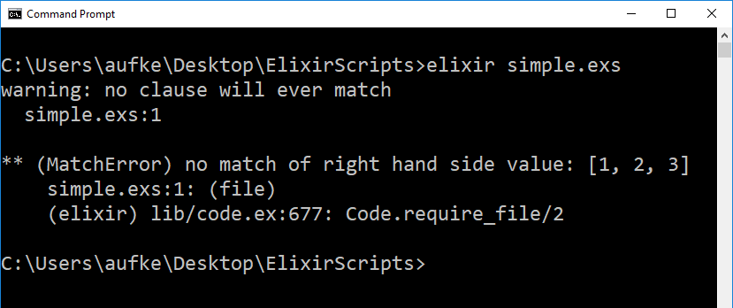
case
We can never get here!
if and unless can’t handle pattern matching gracefully:
Matching returns the right hand side.
UNLESS no match is found, then it yields a MatchError.
If a match is found we’d be OK – [1, 2, 3] is true (non-nil, non-false)

Slide 41
case
Match this tuple successively with each case:
tup = {:ok, "Hello World"}
case tup do
{:ok, result} -> result
{:error} -> "Uh oh!"
_ -> "Catch all"
end
Pattern match!
{:ok, result} = {:ok, "Hello World"}
{:error} = {:ok, "Hello World"}
_ = {:ok, "Hello World"}
Without a catch-all, we’d get an error if no match was found.

Slide 42
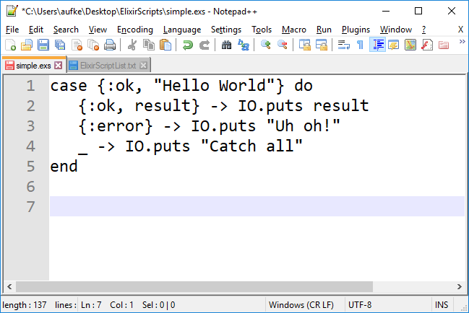
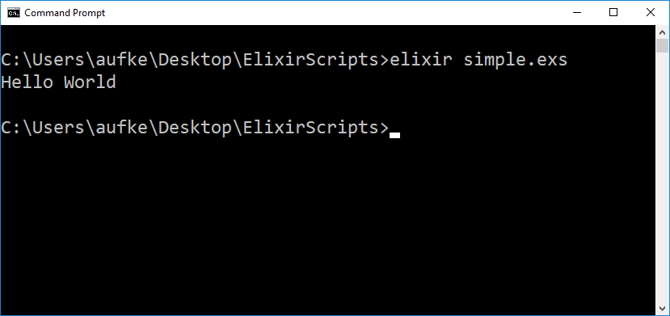

Slide 43
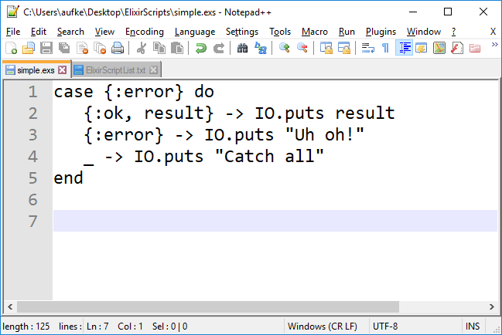
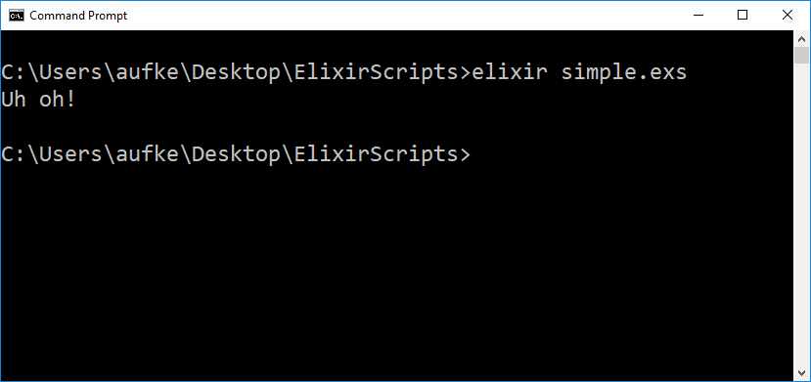

Slide 44
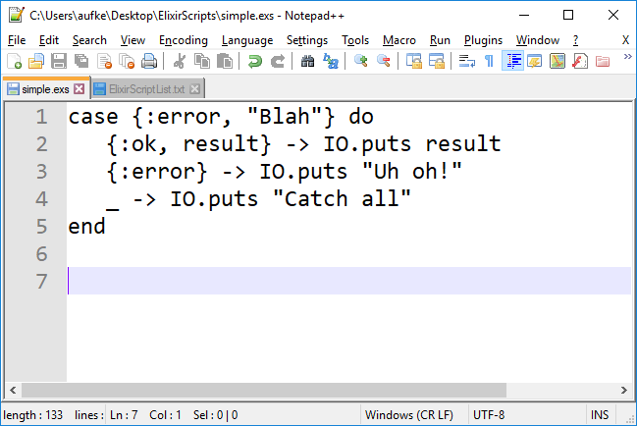


Slide 45

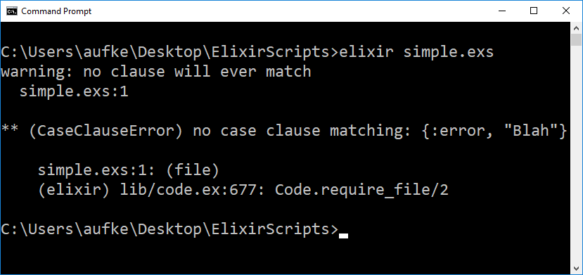
Comment out catch all case

Slide 46
case: Matching Variables
pi = 3.14
IO.puts pi
case "apple pie" do
pi -> IO.puts "Tasty " <> pi
_ -> IO.puts "#{pi} is not tasty"
end
What prints?
Attempts to match: pi = “apple pie”
What’s the problem here?

Slide 47
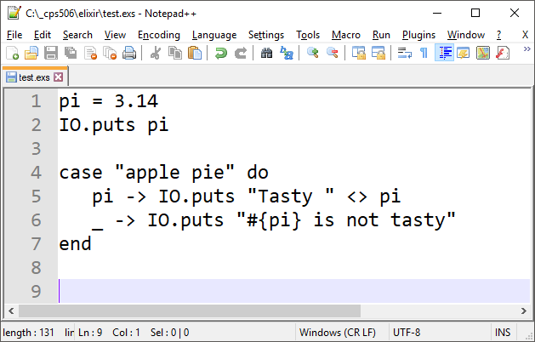
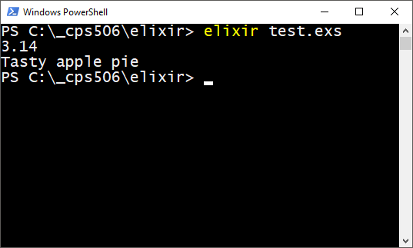
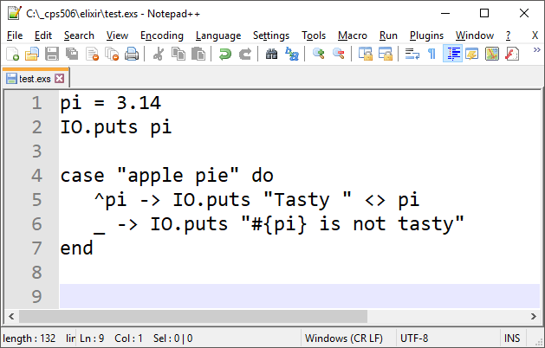
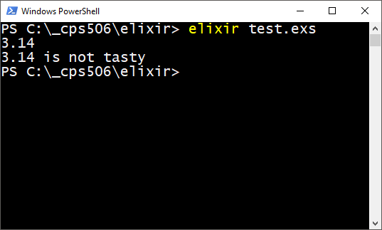
Pin pi using ^

Slide 48
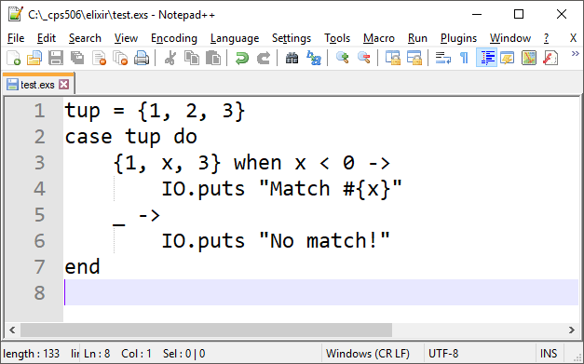
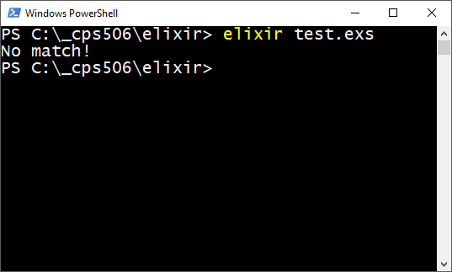
Guard Clauses
Place a condition on the match:
In this case, match is only successful if x < 0
Guard reference: https://hexdocs.pm/elixir/master/guards.html

Slide 49


Guard Clauses
Guard reference: https://hexdocs.pm/elixir/master/guards.html

Slide 50
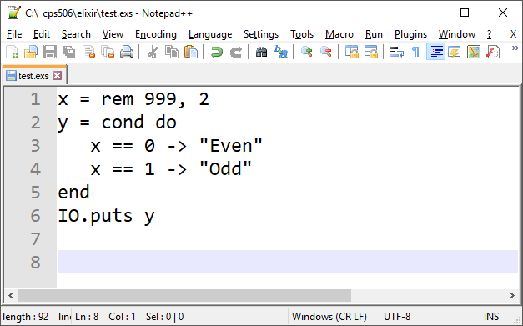
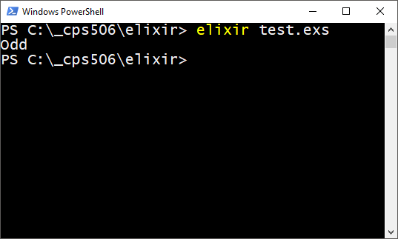
cond
case is for pattern matching, cond is for conditions:
Evaluating cond:
We say y=cond …
Cond evaluates to the final expression under the first true condition.
Similar to a block in Smalltalk

Slide 51
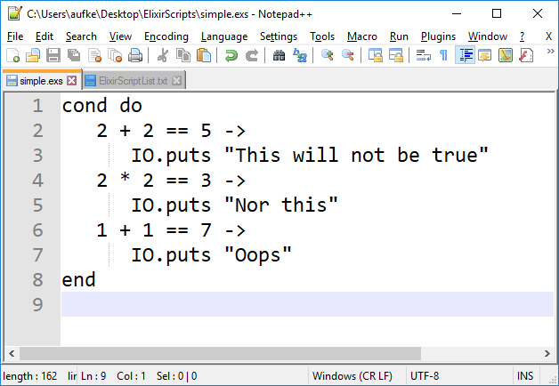
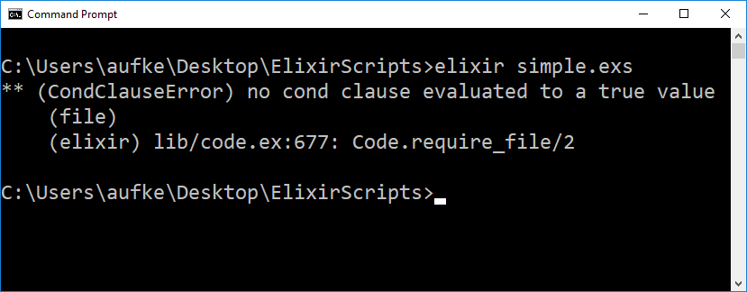

Slide 52
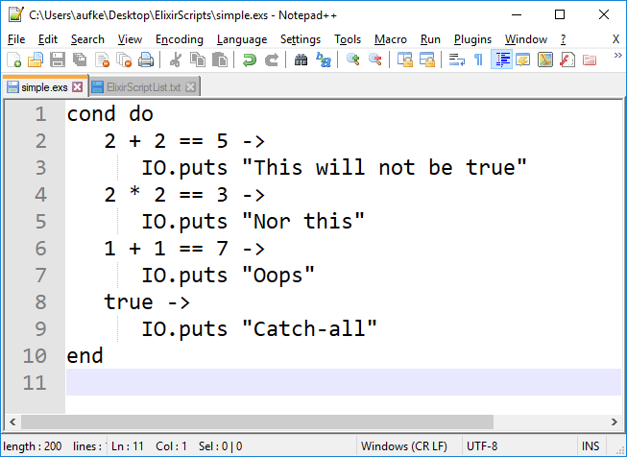
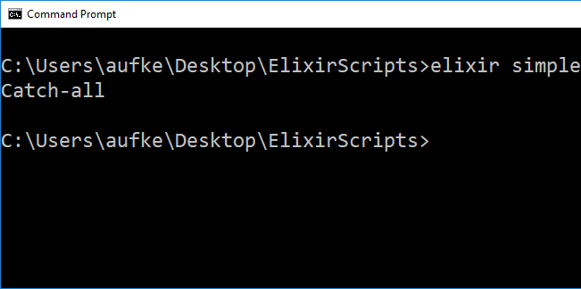
cond: Always have a catch-all

Slide 53

Functions & Patterns

Slide 54
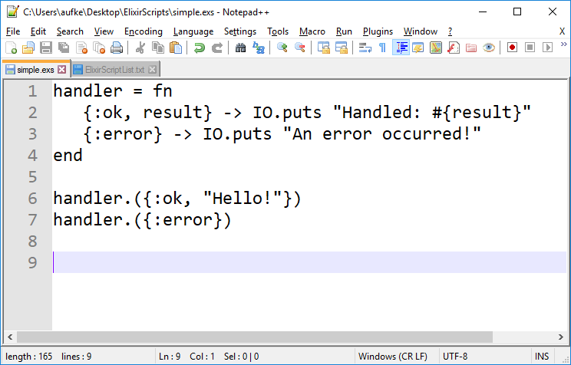
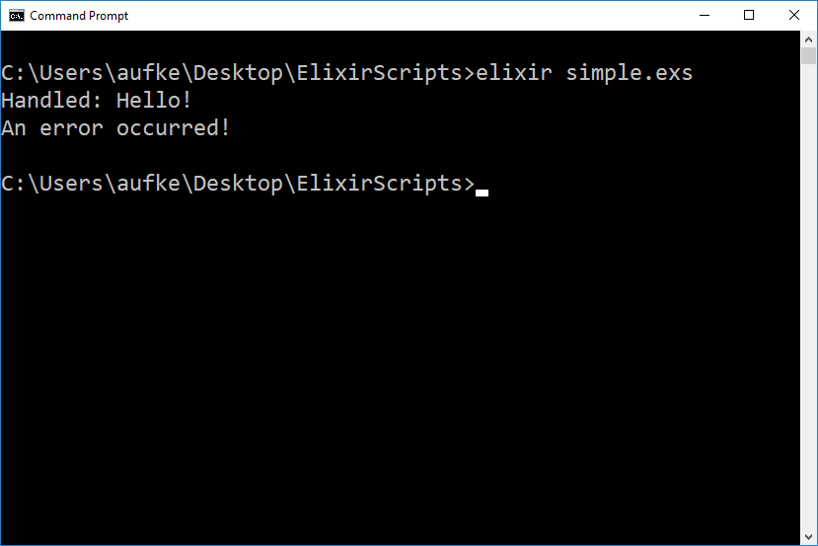
Pattern Matching: Function Signatures
Function “overloading” is just pattern matching on the signature

Slide 55
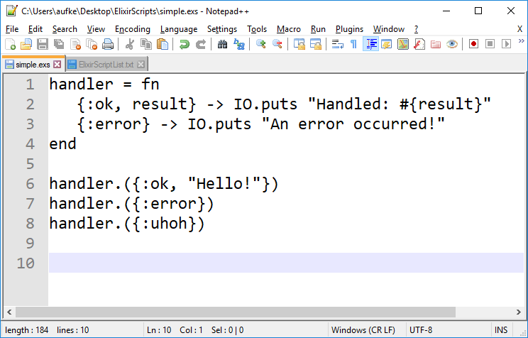
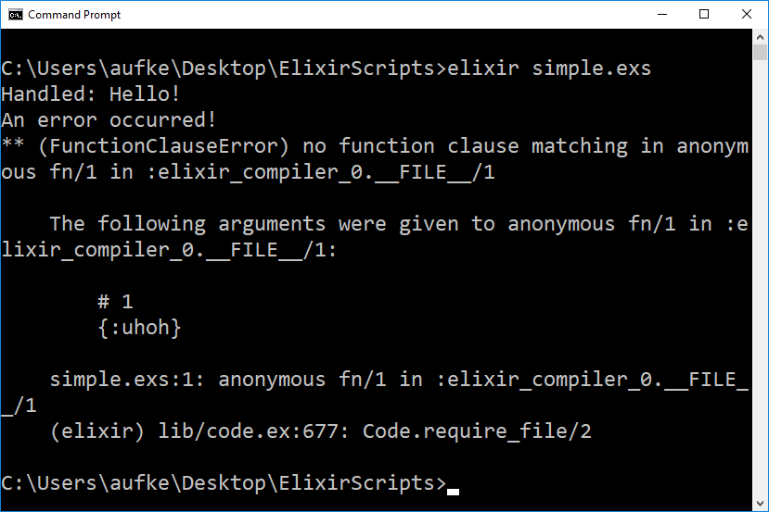
Ideas? What can we do?

Slide 56
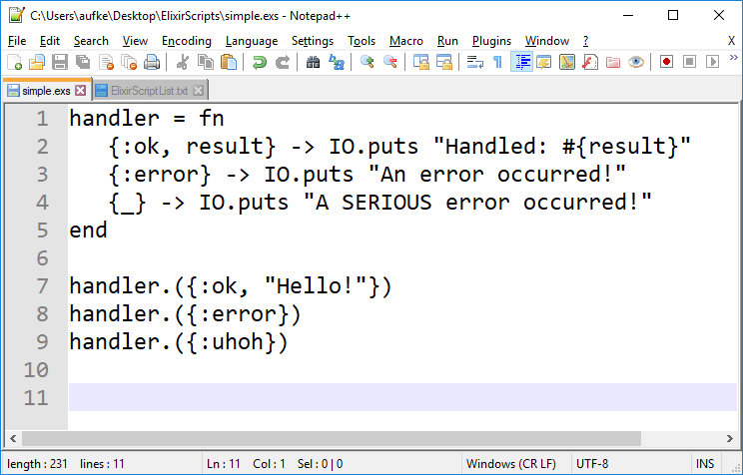
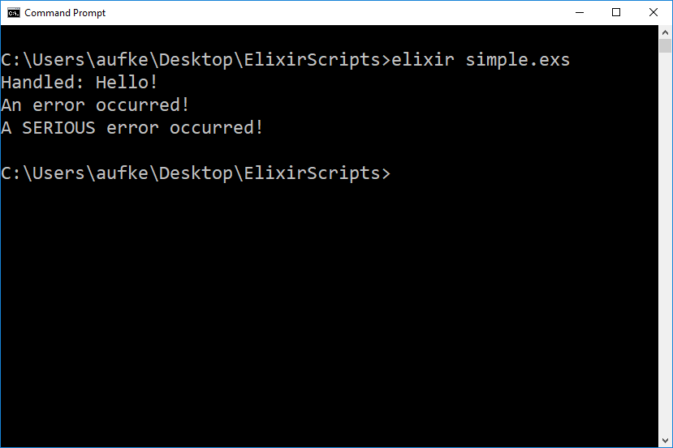

Slide 57
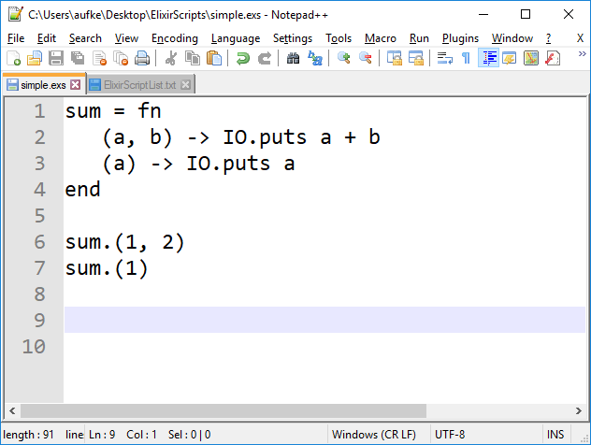
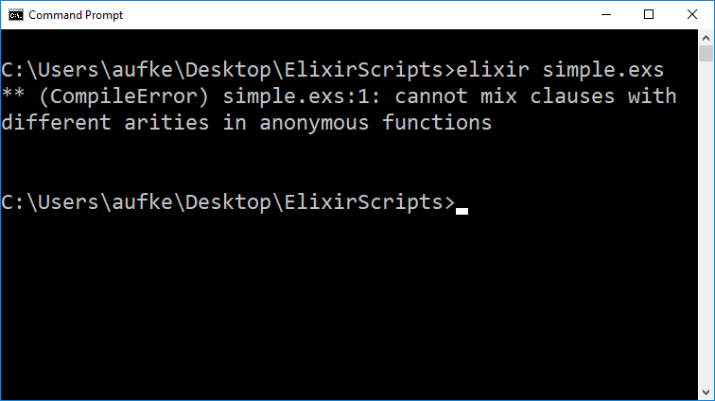
What about…
?
Single argument, a tuple

Slide 58
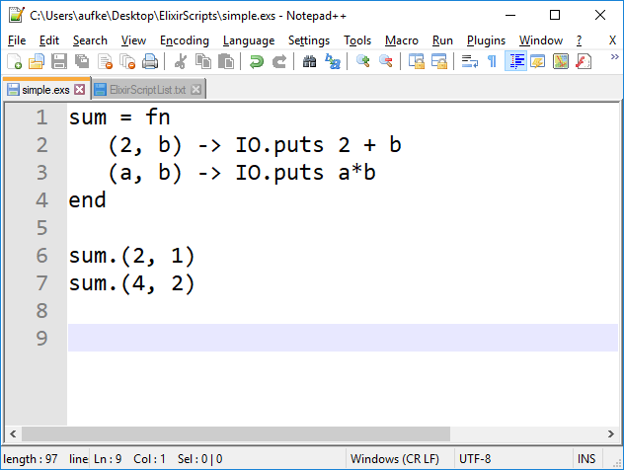
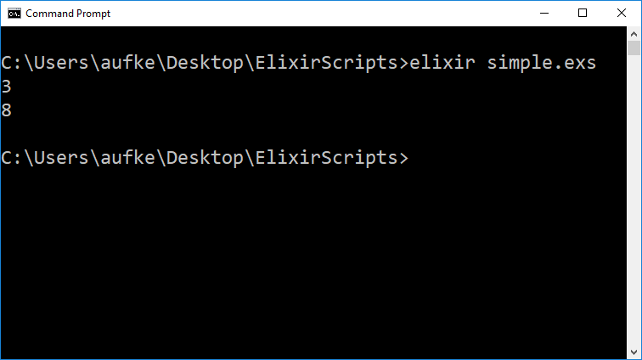

Slide 59


Slide 60
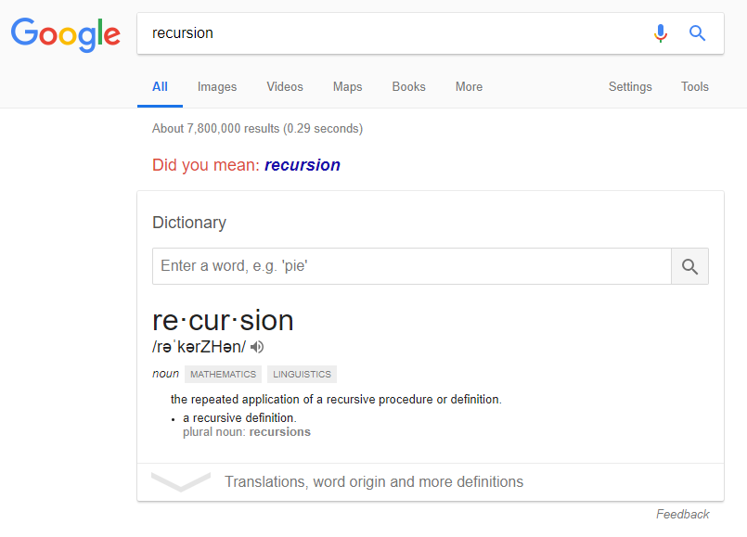

Slide 61
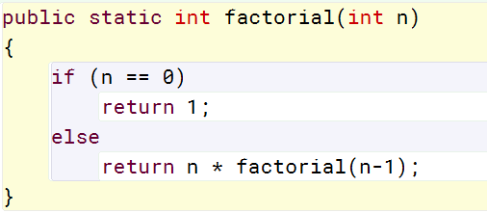
Recursion Refresher
Base Case
Recursive Case

Slide 62
main() calls factorial(5)
public static int factorial (int n)
{
if (n == 0)
return 1;
else
return n * factorial(n-1);
}
False!
factorial(5) calls factorial(4)

Slide 63
main()
… int factorial (int n)
{
if (n == 0)
return 1;
else
return n *
factorial(n-1);
}
… int factorial (int n)
{
if (n == 0)
return 1;
else
return n *
factorial(n-1);
}
… int factorial (int n)
{
if (n == 0)
return 1;
else
return n *
factorial(n-1);
}
factorial(5)
factorial(3)
factorial(1)
… int factorial (int n)
{
if (n == 0)
return 1;
else
return n *
factorial(n-1);
}
… int factorial (int n)
{
if (n == 0)
return 1;
else
return n *
factorial(n-1);
}
… int factorial (int n)
{
if (n == 0)
return 1;
else
return n *
factorial(n-1);
}
factorial(4)
factorial(2)
factorial(0)

Slide 64
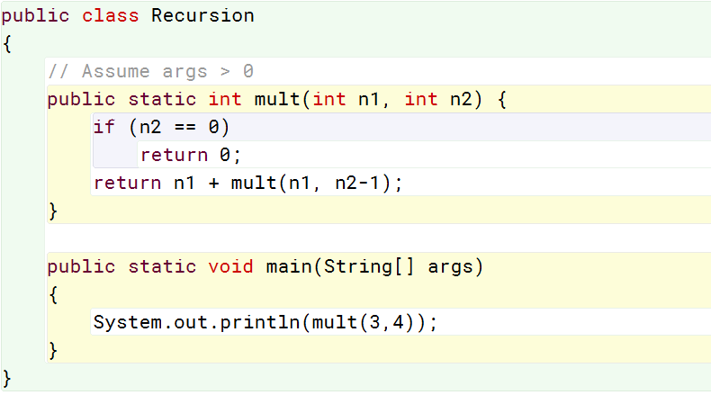
Recursion Refresher
mult(3, 4)
3+ mult(3, 3)
3+(3+ mult(3, 2))
3+(3+(3+ mult(3, 1)))
3+(3+(3+(3+ mult(3, 0))))
3+(3+(3+(3+0)))
12
Salient Property: The result is updated after each call returns.
Return, add. Return, add. Return, add. Return, add. Etc.
We don’t have the final result until the last recursive call returns.

Slide 65
Recursion Refresher
public static int fibonacciRec(int n)
{
if(n < 2)
return 1;
else
return fibonacciRec(n-1) + fibonacciRec(n-2);
}
Overlapping sub-problems!

Slide 66
Overlapping Subproblems?
fib(7)
fib(6)
fib(5)
fib(5)
fib(4)
fib(4)
fib(3)
fib(4)
fib(3)
fib(3)
fib(2)
fib(3)
fib(2)
fib(2)
fib(1)
fib(3)
fib(2)
fib(2)
fib(1)
fib(2)
fib(1)
fib(2)
fib(1)
fib(2)
fib(1)
THIS IS THE DREADED O(2^{n})!

Slide 67


Slide 68
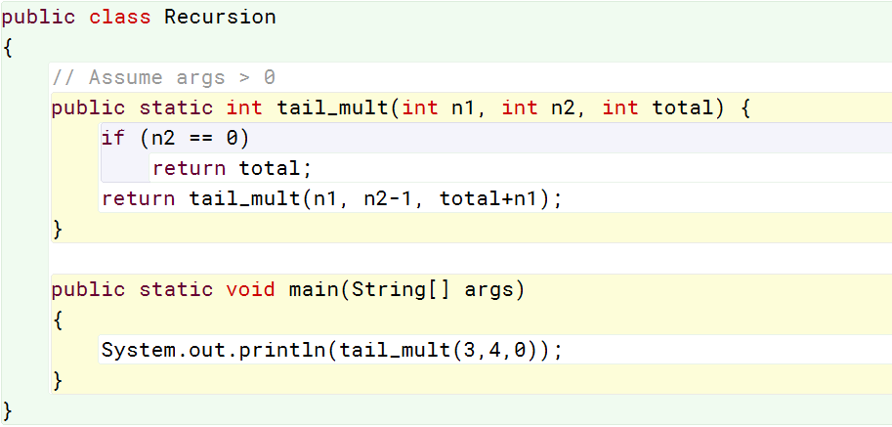
Tail Recursion
tail_mult(3, 4, 0)
tail_mult(3, 3, 3)
tail_mult(3, 2, 6)
tail_mult(3, 1, 9)
tail_mult(3, 0, 12)
12
Here, we have the final result before a single function call returns.
The addition takes place before the recursive call, not after.
Elixir recognizes this and optimizes into iterative machine code.

Slide 69
Tail Recursion
When we’re not doing any computation after the recursive call
mult(3, 4)
3 + mult(3, 3)
3 + (3 + mult(3, 2))
3 + (3 + (3 + mult(3, 1)))
3 + (3 + (3 + (3 + mult(3, 0))))
3 + (3 + (3 + (3 + 0)))
12
tail_mult(3, 4, 0)
tail_mult(3, 3, 3)
tail_mult(3, 2, 6)
tail_mult(3, 1, 9)
tail_mult(3, 0, 12)
12
Here, total is updated each call. This version looks a lot more like iteration. Optimizable!
Every recursive call must complete before we even begin adding values

Slide 70
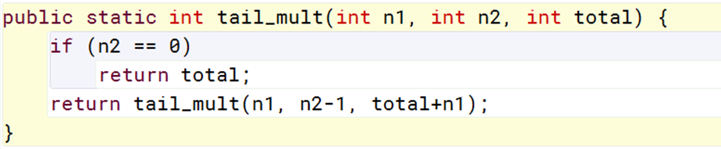
Recursion: Downsides?
Recursion can cause memory use to explode:
Operating on a list with 1000 items requires 1000 recursive calls.
Stack size explodes
Tail recursion mitigates this as we saw, but using tail recursion can often require inelegant code gymnastics.

Slide 71
Tail Recursion: Optimizable?
In Elixir:
Tail recursion does not compile into recursive machine code.
Rather, the compiler recognizes tail recursive source code and compiles it into iterative machine code.
No stack explosion, not function call overhead.
Beware: Recursion with overlapping subproblems will NOT be optimized by the compiler. That’s on you.

Slide 72
Repetition in Elixir
Who needs looping anyway?
defmodule Length do
def of([]), do: 0
def of([_ | t]), do: 1 + of(t)
end
When there’s one value left in the list, t will be [ ]

Slide 73
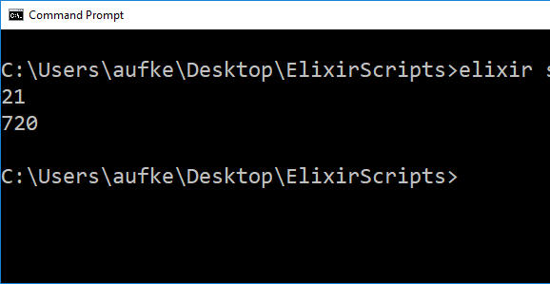
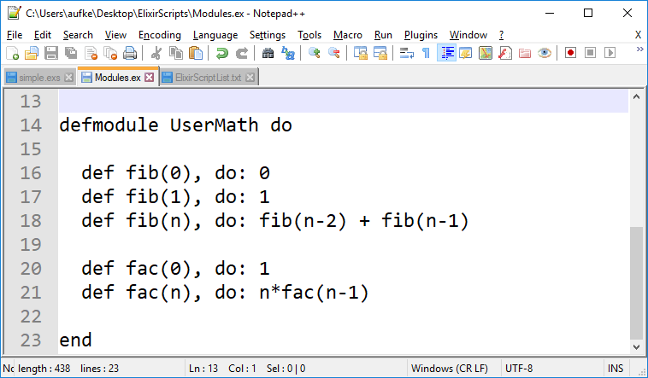
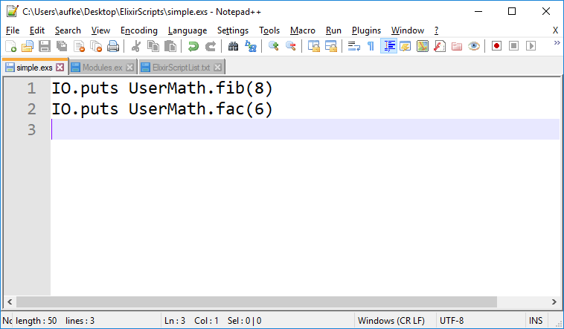
Argument pattern matching makes recursion straightforward:
Base cases
Recursive case

Slide 74
Negative, Non-Integer?
defmodule UserMath do
def fib(n) when not is_integer(n) or n < 0 do
:error
end
def fib(0), do: 0
def fib(1), do: 1
def fib(n), do: fib(n-2) + fib(n-1)
def fac(n) when not is_integer(n) or n < 0 do
:error
end
def fac(0), do: 1
def fac(n), do: n*fac(n-1)
end
Use guards!
and, or, not are comparable to &&, ||, !
and, or, not only work with Boolean values
They don’t operate based on truthiness
Guards expect them

Slide 75
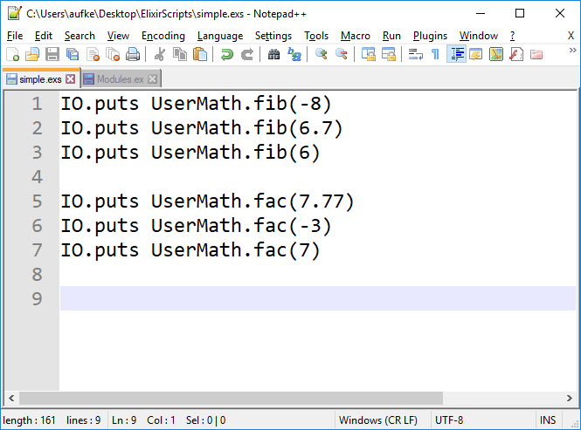
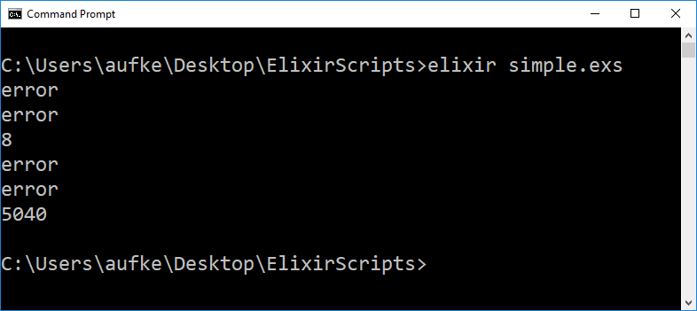

Slide 76
Tail Recursion?
Consider UserMath.fac()
defmodule UserMath do
def fac(0), do: 1
def fac(n), do: n*fac(n-1)
end
Wrapper function so user can invoke without initializing the running product
defmodule UserMath do
def fac(num), do: fac(num, 1)
def fac(1, prod), do: prod
def fac(num, prod), do: fac(num-1, num*prod)
end
Pass running product as argument

Slide 77
Private Functions, Default Arguments
Private function:
Can only be invoked inside Greeter module
defmodule Greeter do
defp hello(), do: "Hello "
def greet(name \\ "Bill"), do: hello() <> name
end
Default argument:
If no argument is provided, name will be “Bill”

Slide 78
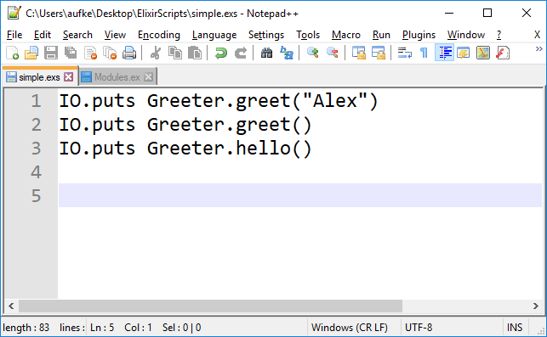


Slide 79
Private Functions, Default Arguments
defmodule UserMath do
def fac(num), do: fac(num, 1)
defp fac(1, prod), do: prod
defp fac(num, prod), do: fac(num-1, num*prod)
end
Hide the tail helper functions from the outside world

Slide 80
Return Values
We don’t have an imperative-style return statement in Elixir
The evaluation of the final expression is returned.
defmodule Silly do
def print() do
"Hello"
","
" "
"World!"
end
end
IO.puts Silly.print()
Four expressions
World!

Slide 81
Higher Order & First Class Functions
Recall: Things that are generally foreign to imperative programming
Higher order functions:
Functions that return functions or accept them as arguments
Named functions are higher order in Elixir
First class functions:
First class functions can be passed as arguments into other functions
Anonymous functions are first class in Elixir

Slide 82
Higher Order & First Class Functions
A function accepting a function as an argument?
defmodule UserMath do
def hof(val, func) do
func.(val)
end
end
Two arguments:
A numeric value and a function
(Or so our function assumes)
Invoke func with val as argument
If argument func is not actually a function?
We will get a run-time type error if/when we try to use it as such.

Slide 83

Same Thing?
Are we not passing a function to another function here?
No! the result of pow() is passed as an argument, not the function itself.

Slide 84


Higher Order & First Class Functions
A function accepting a function as an argument?
defmodule UserMath do
def hof(val, func) do
func.(val)
end
end
Anonymous function to do some operation
Recall – only anonymous functions can be args
Pass value 8 and function sq to hof

Slide 85
Check Argument Type?
defmodule UserMath do
def hof(val, func)
when is_function(func)
do func.(val)
end
def hof(_, _), do: :error
end
Guard to confirm that func is a function
In every other instance, give :error.
Recall: _ means it doesn’t matter what that argument is.

Slide 86



Slide 87
Higher Order & First Class Functions
Returning a function? Let’s see a simple example:
defmodule UserMath do
def funback(what) do
case what do
"add" -> fn a, b -> a + b end
"sub" -> fn a, b -> a - b end
"mul" -> fn a, b -> a * b end
"div" -> fn a, b -> a / b end
_ -> fn _,_ -> :error end
end
end
end
case: Pattern matching on what
Select anonymous function based on what

Slide 88



Slide 89



Slide 90
Enum

Slide 91
Enum
A set of algorithms for enumeration over enumerables! (lists, tuples, and more)
Enum applies functions to lists in various ways. We will see a few:
Enum.all?
# Entire collection must evaluate to true for a given condition
Enum.any?
# Any value in the collection must evaluate true
Enum.map
# Apply a function to every element in the collection
More: https://elixirschool.com/en/lessons/basics/enum/

Slide 92


Enum.all?
Entire collection must evaluate to true for a given condition
Pass list as first arg
Anon function as second arg

Slide 93

Enum.all? We can do it!
Tail recursive!
and the function result with the running Boolean result.
If we hit an element for which f.(h) is false, the entire running Boolean becomes false.

Slide 94

Enum.all? We can do it!

Slide 95

Enum.any?
Any value in collection must evaluate to true for a given condition

Slide 96

Enum.any? We can do it!
Very similar to MyEnum.all
Initialize res to false
Any true value from function f will turn result true.
We are ORing instead of ANDing

Slide 97

Enum.any? We can do it!

Slide 98

Enum.map
Very useful! Apply a function to every element

Slide 99

Enum.map: We can do it!
Result initialized as an empty list
Concatenate [f.(h)] to the running result list

Slide 100

Enum.map: We can do it!

Slide 101
Enum.map: We can do it!
Uhhhh….

Slide 102
Interlude: IO.puts VS IO.inspect
IO.puts can’t handle arbitrary lists:
iex> x = [1, 2.0, "Hello", :world]
[1, 2.0, "Hello", :world]
iex> IO.puts x
** (ArgumentError) argument error
(stdlib) :io.put_chars(:standard_io, :unicode,
[[1, 2.0, "Hello", :world], 10])
IO.puts wants a list containing things it can convert to Unicode.

Slide 103
Interlude: IO.puts VS IO.inspect
We can use IO.inspect:
iex> x = [1, 2.0, "Hello", :world]
[1, 2.0, "Hello", :world]
iex> IO.inspect x
[1, 2.0, "Hello", :world]
[1, 2.0, "Hello", :world]
IO.inspect prints and returns the list.

Slide 104
Interlude: IO.puts VS IO.inspect
We can use IO.inspect:
iex> x = [104, 101, 108, 108, 111]
'hello'
iex> IO.inspect x
'hello'
'hello'
IO.inspect still converts to Unicode!

Slide 105
Interlude: IO.puts VS IO.inspect
We can use IO.inspect:
iex> x = [104, 101, 108, 108, 111]
'hello'
iex> IO.inspect x
'hello'
'hello'
Invoke IO.inspect thusly:
iex> IO.inspect x, charlists: :as_lists
[104, 101, 108, 108, 111]
'hello'
Prints list as a list, rather than converting to Unicode.

Slide 106
Interlude: IO.puts VS IO.inspect
IO.inspect x, charlists: :as_lists
Recall keyword list form:
IO.inspect(x, [{:charlists, :as_lists}])

Slide 107


Enum.reduce
Distill collection to single value based on some function
acc is the running value
By default, initialized to first element in list

Slide 108
Enum.reduce
Distill collection to single value based on some function
(9 - (8 - (7 - (6 - (5 - (4 - (3 - (2 - (1 – (0 – acc)…)
VS
(…(acc – 1) – 2) – 3) – 4) – 5) – 6) – 7) – 8) – 9)

Slide 109

Enum.reduce: We can do it!
Result initialized as head of list
Pass head of list and current result into f

Slide 110

Enum.reduce: We can do it!

Slide 111
acc is the running value
By default, initialized to first element in list
We can add an optional 3rd argument to initialize acc:
iex> Enum.reduce([1, 2, 3], 10, fn(x, acc) -> x+acc end)
16
iex> Enum.reduce([1, 2, 3], fn(x, acc) -> x+acc end)
6
10 + 1 + 2 + 3
VS
1 + 2 + 3

Slide 112
In Summary:
Pattern matching
Control structures
Recursion
Higher order & first class functions
Enum

